Slide 1
Graduate Artificial Intelligence CS 640 Search
Jeffrey Considine
jconsidi@bu.edu

Slide 2

Plan for Today
Search as a universal algorithm?
Basic search algorithms
Search with costs
Search with heuristics
Search with admissible heuristics
Memory-bounded search

Slide 3
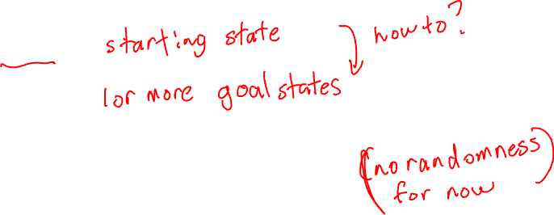
Modeling Search Problems
Typical abstraction models problem as graph.
Nodes are states.
Edges are possible transitions between states.
Maybe labeled by action causing transition.

Slide 4
Search as a Path-Finding Algorithm
Search finds reachable nodes.
So, finding a node implies a path.

Slide 5
Search as a Planning Algorithm
Each node represents a state with all problem-relevant information.
Each action represented by an edge to the next state.
Can search find a path from the start state to a goal state?
If we find a path to the goal, what is the plan to achieve the goal?

Slide 6
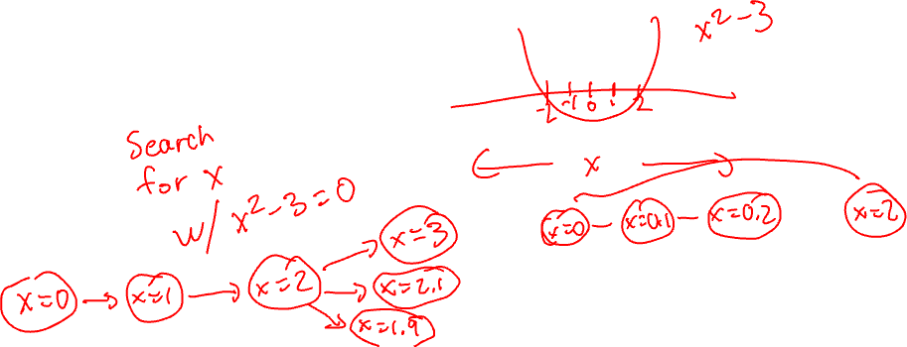
Search as Solving Algorithm
Can search find a path from the start state to a state that represents a solution?

Slide 7
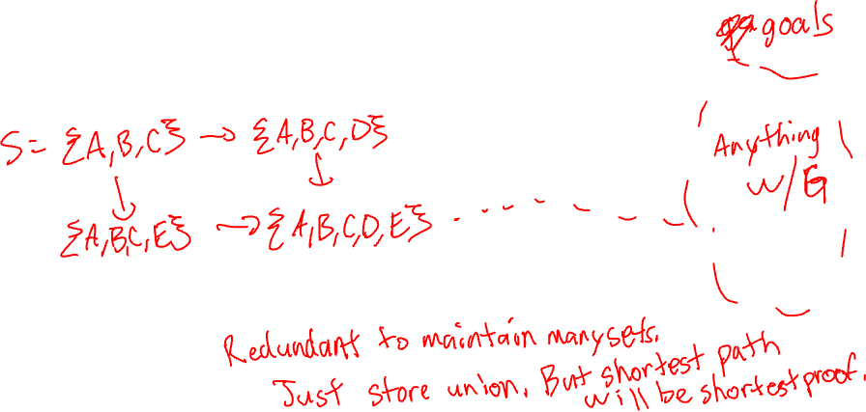
Search and Rule-based Systems
Each node represents set of known/proven facts.
Each edge represents adding a new fact.
Is this a good fit?

Slide 8
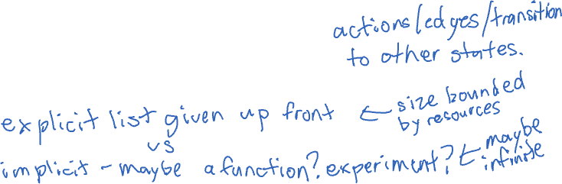
Typical Search Assumptions
Start node is known.
If you see a goal state’s node, you recognize it as a goal state.
From any node, you can identify all possible...
But do not necessarily have list of all nodes up front.

Slide 9
Explicit vs Implicit Graphs
An explicit graph representation usually makes search easy.
What if we are given an implicit representation, like a function returning edges for a node?

Slide 10
Search Challenges
The number of all nodes might be too big to store in memory.

Slide 11
Any Questions?

Slide 12
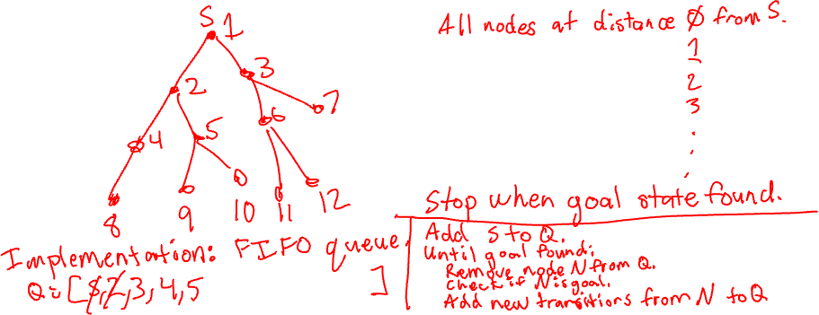
Breadth-First Search (BFS)
Follow edges from the earliest discovered nodes first.

Slide 13
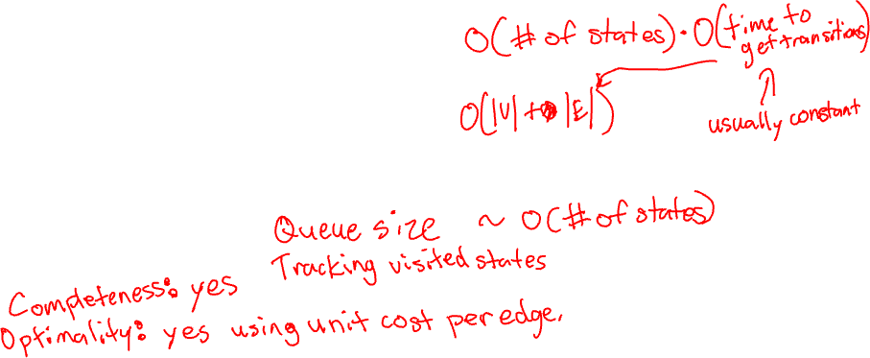
Breadth-First Search Performance
Assuming a FIFO queue for implementation…
How much time to search a graph?
How much memory to search a graph?

Slide 14
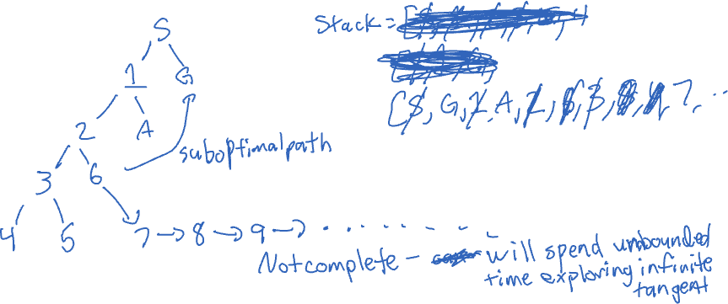
Depth-First Search (DFS)
Follow edges from the most recently discovered nodes first.

Slide 15
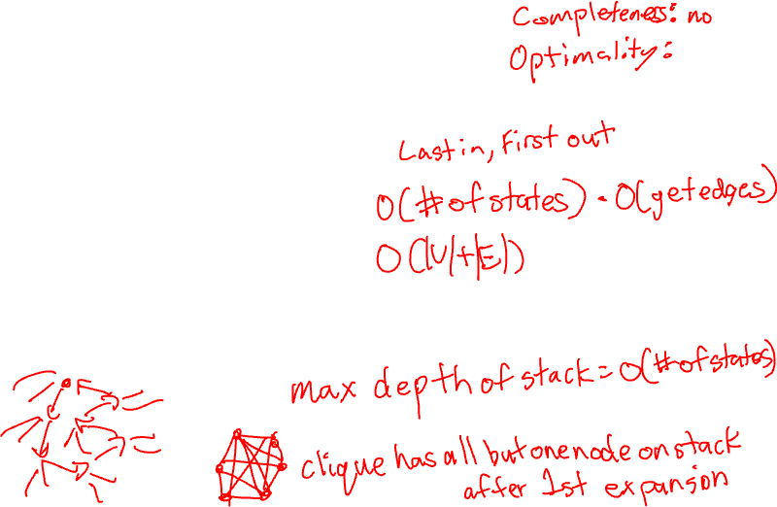
Depth-First Search Performance
Assuming a stack for implementation…
How much time to search a graph?
How much memory to search a graph?

Slide 16
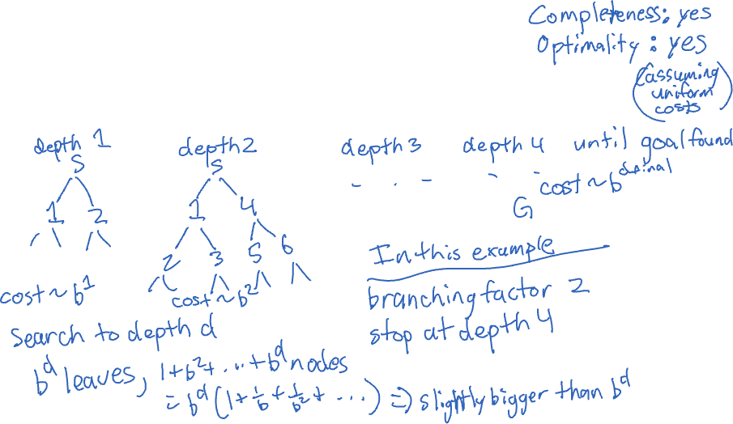
Iterative Deepening
Depth-bounded DFS with increasing depth bounds.

Slide 17
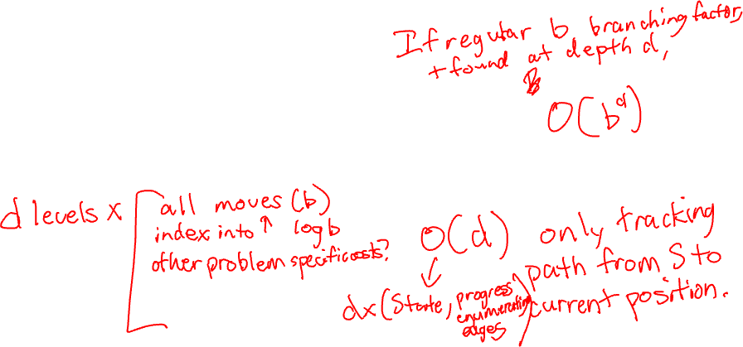
Iterative Deepening Performance
How much time to search a graph?
How much memory to search a graph?

Slide 18
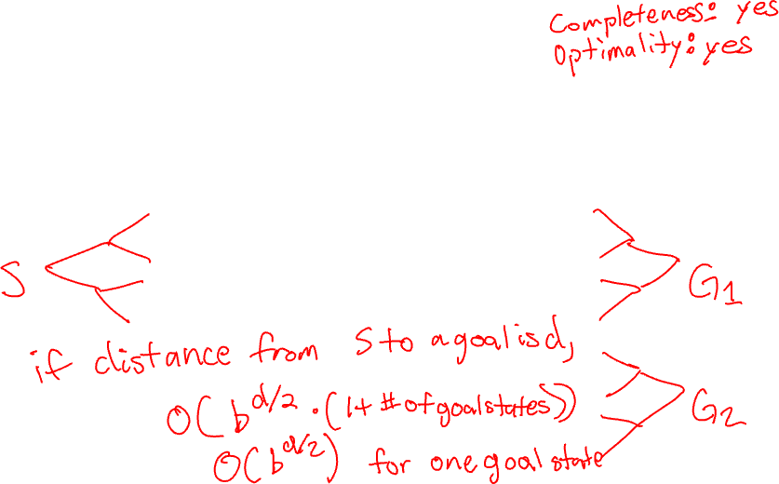
Bidirectional Search
Search alternates expanding from start and from goal states.
Stop when overlap found.

Slide 19
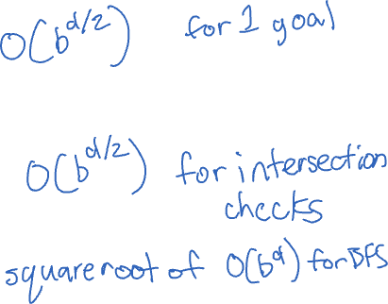
Bidirectional Search Performance
How much time to search a graph?
How much memory to search a graph?

Slide 20
Limitations of Uninformed Search
???

Slide 21
Any Questions?

Slide 22
Search with Costs
So far, just searched for any path from start state to a goal state.
What if some edges (actions) are more expensive?
Shorter/cheaper paths may be preferable.

Slide 23
Dijkstra’s Algorithm
Common single source shortest path algorithm…

Slide 24
Dijkstra’s Algorithm as Uniform Cost Search
Dijkstra’s algorithm finishes vertices in increasing order of cost.

Slide 25
Unit Costs and Breadth-First Search
If all edge costs are the same, then BFS give also gives us minimum cost paths.

Slide 26
Bidirectional Search with Costs
Does this work?

Slide 27
Any Questions?

Slide 28
Informed Search
How can we do better than brute force searching all nodes?

Slide 29
Domain Knowledge
If we know about our problem, can we use that for a performance edge?

Slide 30
Heuristic Functions
A heuristic is a best guess about which nodes are better or worse.
No guarantees!

Slide 31
Best-First Search
Generic best-first search: Prioritize search with a plug-in function to order nodes.
Breadth first search: best-first ordered by increasing discovery order.
Depth first search: best-first ordered by decreasing discovery order.
Generic implementation uses a priority queue…

Slide 32
Greedy Best-First Search
Best-first search using a heuristic to order nodes.

Slide 33
Any Questions?

Slide 34
What if our heuristics are better than a guess?
Can we start making guarantees?

Slide 35
A* Algorithm
Best first search where heuristic = (best distance to node) + (estimated distance to goal)
What can we do with this?

Slide 36
Admissible Heuristics
An admissible heuristic returns a lower bound on the remaining cost from a node to a goal state.
How does this work with A*? heuristic = (best distance to node) + (lower bound to goal)

Slide 37
Optimality of A*
What can we guarantee with A*?

Slide 38
A* vs Dijkstra’s Algorithm
???

Slide 39
Satisficing Search
What if heuristic is not admissible, but close?

Slide 40
Any Questions?

Slide 41
Memory-Bounded Search
Previous challenge: too many nodes for memory.
Previous answer: iterative deepening.
Can we handle cost-bounded searches with memory bounds?

Slide 42

Beam Search
Idea: Keep best $k$ at each depth.
This was a common practice for early large language models.

Slide 43
Iterative-Deepening A* (IDA*)
Idea: iterative deepening, but use increasing cost bounds instead of depth bounds.

Slide 44
Any Questions?

